Slide 1
ENGLISH 8
UNIT 1- LEISURE ACTIVITIES
Lesson 2: A closer look 1+ Looking back ( Vocabulary)

Slide 2
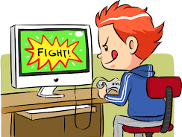
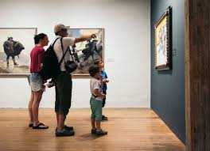
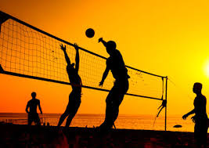
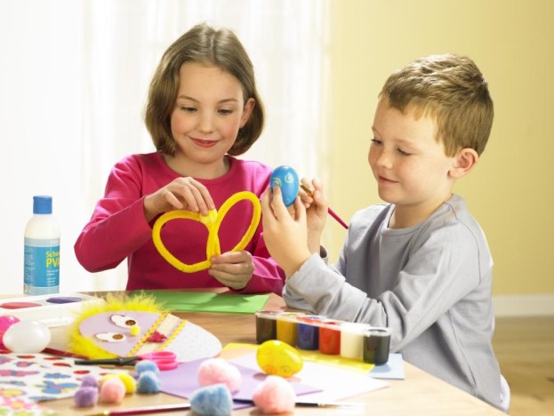
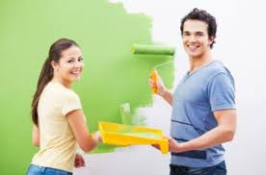
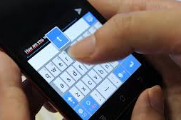
WARM-UP: Name the pictures
Playing computer games
Visiting museums
Playing
beach games
Making crafts
Doing DIY
Texting

Slide 3
UNIT1: LEISURE ACTIVITIES
Lesson 1: Acloser look 1 + Looking back ( vocabulary)
* Vocabulary:
- socialise (v):
giao lưu, giao tiếp để tạo mối quan hệ.
- communicate (v):
giao tiếp
- pie chart (n):
biểu đồ hình tròn

Slide 4
1. Look at the pie chart on leisure activities in the USA.
LEISURE TIME ON AN AVERAGE DAY
Relaxing and thinking
(17 minutes)
Other leisure activities
(18 minutes)
Using the computer
(25 minutes)
Watching TV
(2.8 hours)
Doing sports and exercise
(19 minutes)
Reading
(20 minutes)
TOTAL LEISURE AND SPORTS TIME = 5.1 HOURS
Socialising and communicating
(39 minutes)

Slide 5
1. Look at the pie chart and answer the questions. (Ex. 1/p.8)
How much leisure time did people in the US have on an average day in 2012?
…………………………………………………………………………….
2. What did they do in their leisure time?
……………………………………………………………………………..
3. What were the three most common activities?
……………………………………………………………………………..
5.1 hours.
Reading, watching TV, using computers, …
Watching TV, socialising and communicating, and using the computer.

Slide 6
2. Complete the table with information from the pie chart. (Ex. 2/p.8)
Name of activity | Verb
Relaxing | relax
Thinking think
Using use
Doing do
Watching watch
Reading read
Socialising socialise
Communicating communiate

Slide 7
3. Look at the words. Match them to the category labels.
(Ex. 3/p.8)
1. skateboarding, football, badminton
3. the news, a reality show, a comedy
2. a novel, poetry, a magazine
6. going to local performances, visiting museums.
4. a new language, a skill
5. collecting stamps, making origami
7. visiting relatives, going shopping, doing DIY
8. texting, going to the cinema, hanging out
a. Learning something interesting
b. reading
c. Spending time with family
d. Having hobbies
e. Playing sports
f. Watching TV
g. Socialising with friends
h. Going to cultural places

Slide 8
Discuss: (Ex. 4/p.8)
1. How much time do you spend a day on leisure activities?
- One hour
2. What are the three activities that you do the most?
- Watching TV, reading, playing sports.
3. What were the three most common activities?
The three most common activities were watching TV, socialising and
communicating, and using computers for leisure.

Slide 9
II. PRONUNCIATION
Clusters: /br/ or /pr/

Slide 10
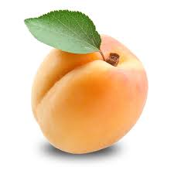
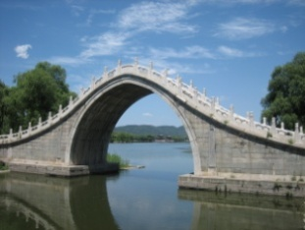
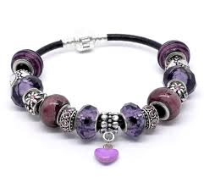
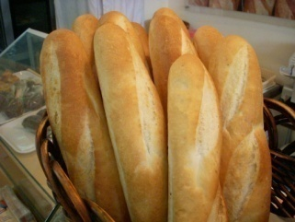
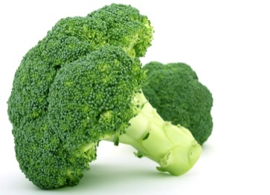
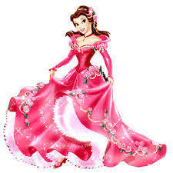
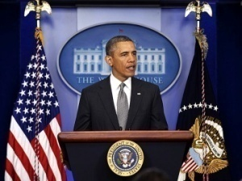
1. Complete the words under the pictures with /pr/ or /br/.
(Ex. 1/p.8)
br
br
2. ____ ridge
3. ___acelet
pr
br
4._____ead
1. a ___icot
pr
pr
pr
5. ___incess
6._____ esident
7. ___esent
8. ___occoli
br

Slide 11
2. Listen and repeat. (Ex. 1/p.8)
She loves making apricot jam.
My dad likes making bread in his free time.
Hen is our club president.
Mai keeps all her bracelets in a beautiful bags.
You will need a brush if you want to paint your room.
This is a wonderful present. Thanks so much!

Slide 12
* LOOKING BACK ( Vocabulary)
1) Which one is the old one out?:
1. a comedy, a movie, DIY, a thriller
2. emailing, hanging out, blogging, surfing the net
3. cinema, museum, hospital, community centre
4. love, fancy, like, enjoy, detest
5. good, boring, exciting, relaxing
6. ☺,<3,computer,how r u?

Slide 13
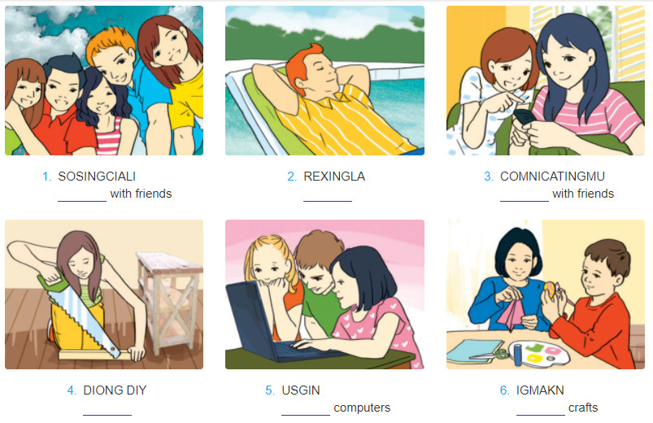
2) Rearrange the letters to find the name of the activities:
socialising
relaxing
communicating
doing
using
making

Slide 14
III. AT HOME
Practice Clusters /br/ or /pr/ again.
Be ready for A CLOSER LOOK 2+ Looking back ( grammar)

