Slide 1

UNIT 1. LOCAL ENVIRONMENT
Lesson 4:Communication

Slide 2

UNIT 1. LOCAL ENVIRONMENT
Lesson 4: communication
Things you should do to prepare for a class trip

Slide 3

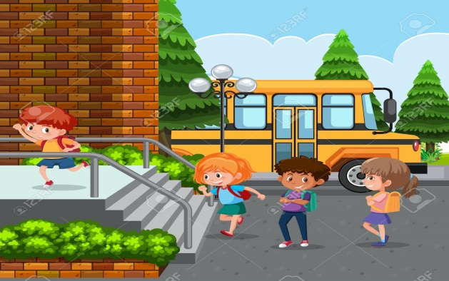

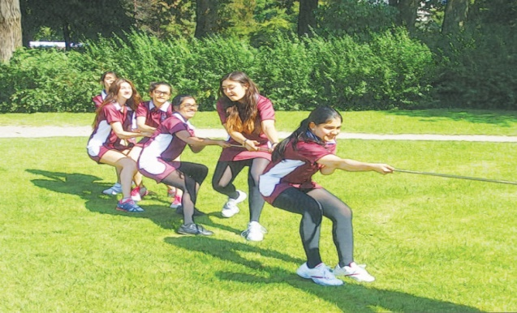
Complete the sentences using the given words/ phrases.
team-building
turn up
first aid kit
set off
1. If she doesn’t .................... by 6.15, they will leave the party.
2. Do you know what time we will .................... tomorrow?
3. You should have your ............................. in your backpack when you go on a trip.
4. We like playing……………………….games such as: tug of war, ten thousand mile shoe, sack jump.
1.Turn up 2.set off 3.first aid kit 4. team- building
arrive

Slide 4

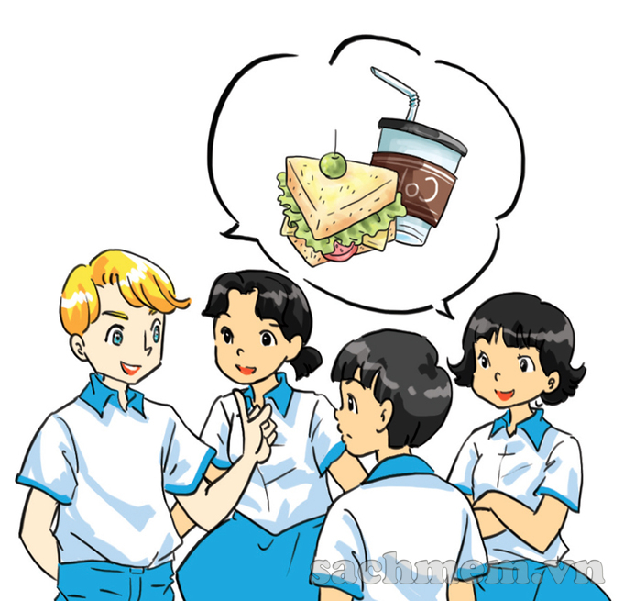
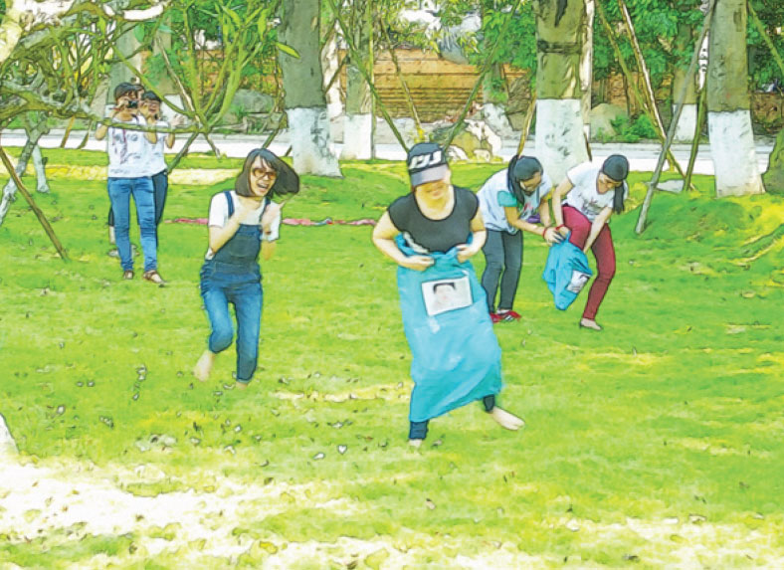
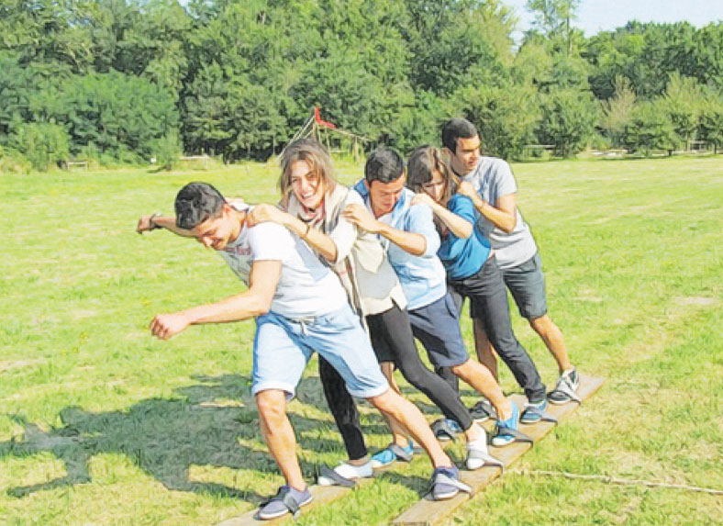

1. Nick, Mi , Duong and Mai are planning a day out to a place of interest for their class. Listen to the conversation and complete their plan.

Slide 5

1. Nick, Mi, Duong, and Mai are planning a day out to a place of interest for their class. Listen to their conversation and complete their plan by filling each blank with no more than three words.
A DAY OUT
 | Details | Who to prepare
Place | (1)_________________
Means of transport | (2)__________________
Time to set off | (3)__________________ | Mai: stick a notice
Food | (4) bring_____________
Drinks | For everyone | Nga: buy in (5)_____________
Activities | Morning: (6)_____________ games and quizzes Lunch: 11.30 Afternoon: go to traditional (8)_________________ at 1.30; (9)____________ their own paintings | Nick: prepare games Thanh: prepare (7) _______
Time to come back | (10) _______________
Green Park
Green Park
bus
bus
8 a.m
8 a.m
own lunch
own lunch
supermarket
supermarket
team-building
team-building
quizzes
quizzes
painting village
painting village
make
make
5 p.m
5 p.m

Slide 6
a. I think we should prepare our own lunch. And Nga will buy drinks for everyone in the supermarket.
What about the activities? In the morning, we are going to play team-building games and quizzes. Nick will prepare the games and Thanh will prepare the quizzes.
We will have lunch at 11.30.
b. We decided that we are going to Green Park. We can go there by bus. My friends and I are going to turn up at the school gate at 8 a.m. Mai will stick the notice on the board tomorrow.
c. In the afternoon, we can visit the traditional painting village there.
d. Finally, we will take the bus back to school at 5 p.m.
That’s all. Thank you for listening.
e. Hi guys. I’m Vinh. I’m very excited to stand here to present our plan to you.

Slide 7
e. Hi guys. I’m Vinh. I’m very excited to stand here to present our plan to you.
b. We decided that we are going to Green Park. We can go there by bus. My friends and I are going to turn up at the school gate at 8 a.m. Mai will stick the notice on the board tomorrow.
a. I think we should prepare our own lunch. And Nga will buy drinks for everyone in the supermarket.
What about the activities? In the morning, we are going to play team-building games and quizzes. Nick will prepare the games and Thanh will prepare the quizzes.
We will have lunch at 11.30.
c. In the afternoon, we can visit the traditional painting village there.
d. Finally, we will take the bus back to school at 5 p.m.
That’s all. Thank you for listening.

Slide 8
2. Imagine that your class is going to a place of interest in your area. Work in group to discuss the plan for this day out. Make notes in the table.
3. Present your plan to the class. Which group has the best plan?
 | Details | Who to prepare
Place
Means of transport
Time to set off
Food
Drinks
Activities
Time to come back
Other(s) ………..

Slide 9

HOMEWORK
- Write a passage telling your group’s plan for a day out.
- Prepare: Skills 1

