Slide 1

ENGLISH 9
NGUYỄN THỊ MỸ LINH
Tan My Secondary School.

Slide 2

Tent
food
Things you should do to prepare for a class trip
camera
drink
smart phone

Slide 3
Tuesday, September 14th,2021
UNIT 1. LOCAL ENVIRONMENT
Lesson 4: COMMUNICATION+ LOOKING BACK
( Communication)

Slide 4


      UNIT 1: LOCAL ENVIRONMENT
      LESSON 4: COMMUNICATION
*.Vocabulary:
team-building (adj):
xây dựng đội ngũ
turn up (ph.v) :
xuất hiện, đến
set off (ph.v):
khởi hành
first aid kit :
Bộ đồ sơ cứu

Slide 5

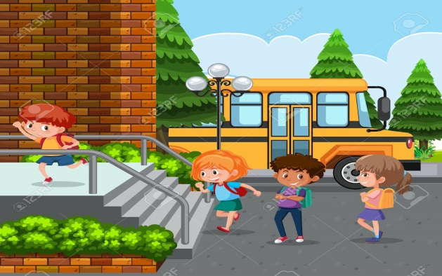

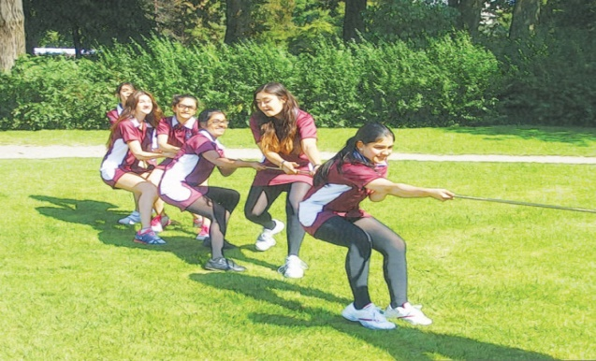
s
Complete the sentences using the given words/ phrases.
turn up
team-building
set off
first aid kit
turn up
1. If she doesn’t .................... by 6.15, they will leave the party.
2. Do you know what time we will .................... tomorrow?
3. You should have your ............................. in your backpack when you go on a trip.
4. We like playing……………………….games such as: tug of war, ten thousand mile shoe, sack jump.
set off
first aid kit
team-building
arrive

Slide 6
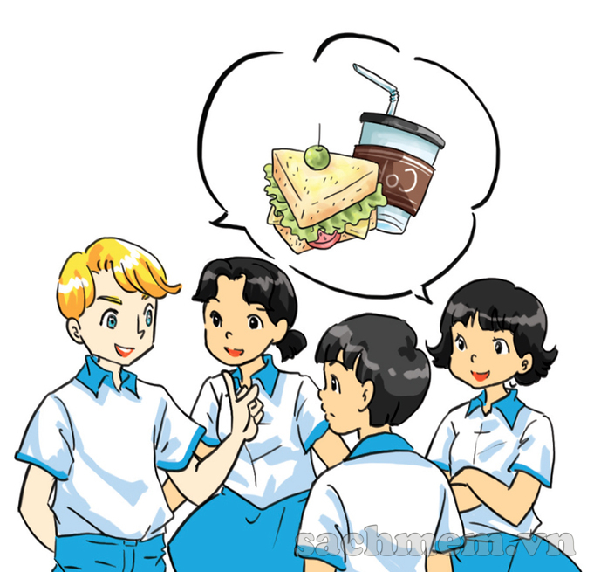
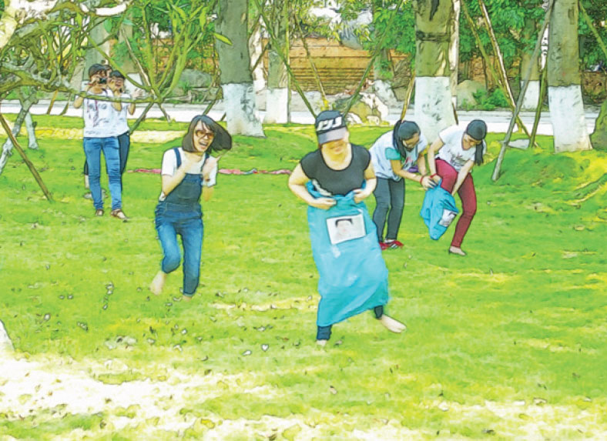
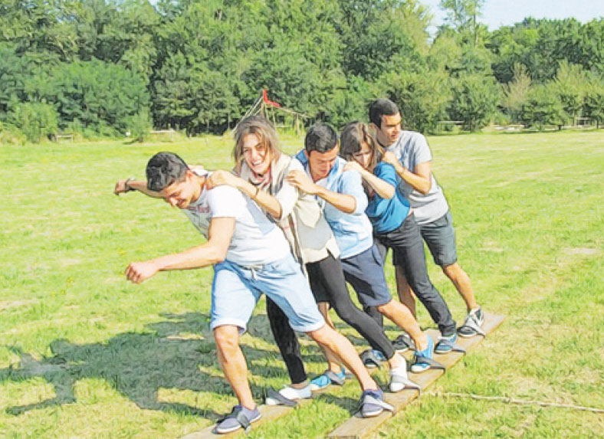

1. Nick, Mi , Duong and Mai are planning a day out to a place of interest for their class. Listen to the conversation and complete their plan.
sack jump
ten thousand mile shoe
tug of war

Slide 7

1. Nick, Mi, Duong, and Mai are planning a day out to a place of interest for their class. Listen to their conversation and complete their plan by filling each blank with no more than three words.
A DAY OUT
 | Details | Who to prepare
Place | (1)_________________
Means of transport | (2)__________________
Time to set off | (3)__________________ | Mai: stick a notice
Food | (4) bring_____________
Drinks | For everyone | Nga: buy in (5)_____________
Activities | Morning: (6)_____________ games and quizzes Lunch: 11.30 Afternoon: go to traditional (8)_________________ at 1.30; (9)____________ their own paintings | Nick: prepare games Thanh: prepare (7) _______
Time to come back | (10) _______________
Green Park
Green Park
bus
bus
8 a.m
8 a.m
own lunch
own lunch
supermarket
supermarket
team-building
team-building
quizzes
quizzes
painting village
painting village
make
make
5 p.m
5 p.m

Slide 8
a. I think we should prepare our own lunch. And Nga will buy drinks for everyone in the supermarket.
What about the activities? In the morning, we are going to play team-building games and quizzes. Nick will prepare the games and Thanh will prepare the quizzes.
We will have lunch at 11.30.
b. We decided that we are going to Green Park. We can go there by bus. My friends and I are going to turn up at the school gate at 8 a.m. Mai will stick the notice on the board tomorrow.
c. In the afternoon, we can visit the traditional painting village there.
d. Finally, we will take the bus back to school at 5 p.m.
That’s all. Thank you for listening.
e. Hi guys. I’m Vinh. I’m very excited to stand here to present our plan to you.

Slide 9
e. Hi guys. I’m Vinh. I’m very excited to stand here to present our plan to you.
b. We decided that we are going to Green Park. We can go there by bus. My friends and I are going to turn up at the school gate at 8 a.m. Mai will stick the notice on the board tomorrow.
a. I think we should prepare our own lunch. And Nga will buy drinks for everyone in the supermarket.
What about the activities? In the morning, we are going to play team-building games and quizzes. Nick will prepare the games and Thanh will prepare the quizzes.
We will have lunch at 11.30.
c. In the afternoon, we can visit the traditional painting village there.
d. Finally, we will take the bus back to school at 5 p.m.
That’s all. Thank you for listening.

Slide 10
2. Imagine that your class is going to a place of interest in your area. Work in group to discuss the plan for this day out. Make notes in the table.
 | Details | Who to prepare
Place
Means of transport
Time to set off
Food
Drinks
Activities
Time to come back
Thong Nhat park
bike
9 a.m
Bring lunch for everyone
Ly and I prepare at home
Buy in the supermarket
Nhung
+ Morning: pitch a tent
+ Lunch:
- have lunch
- chat with each other
- sing favorite songs
Thinh, Trang, Trinh
everyone
+ Afternoon:
- wander around the park
- enjoy the fresh air
5 p.m

Slide 11
3. Present your plan to the class. Which group has the best plan?
 | Details | Who to prepare
Place
Means of transport
Time to set off
Food
Drinks
Activities
Time to come back
Other(s) ………..

Slide 12


HOMEWORK
- Learn new words by heart.
- Prepare: Skills 1

