Slide 1
WELCOME TO OUR CLASS
Unit 1 lOCAL ENVIRONMENT
LESson 3: A closer look 2

Slide 2
I. Vocabulary
- to pass down: truyền lại (generation)
- to live on: sống nhờ vào ( enough money)
- to close down: dừng công việc ( stop)
- to face up to:chấp nhận ( accept) ( reality ) sự thật
- to get on with: hòa thuận với ( friendly relationship)
- to turn down: từ chối, phản đối ( reject / refuse)
- to bring out = publish/ launch: xuất bản
- to look through = to read: đọc
- to keep up with = stay equal with: theo kịp ai/ cái gì
- So that = in order that : để mà

Slide 3
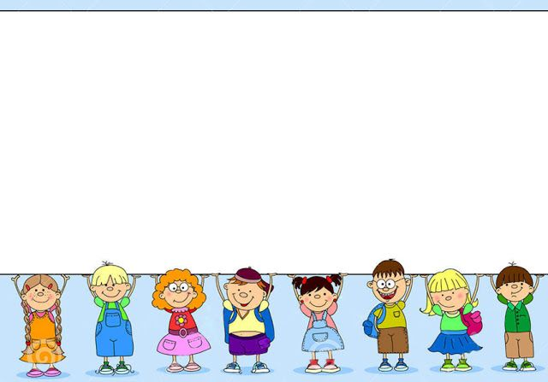
II.PHRASAL VERBS

Slide 4
II. Phrasal verbs
3. Read this part of the conversation from GETTING STARTED. Pay attention to the underlined part and answer the questions.
Mi:
Wow! When did your grandparents set up this workshop?
Phong:
My great-grandparents started it, not my grandparents. Then my grandparents took over the business.
What is the meaning of the underlined verb phrases?
2. Can each part of the verb phrase help you understand its meaning?
set up : start something (a business, an organization, etc.)
take over : take control of something (a business, an organization, etc.)
No, the individual words in the verb phrase do not help with comprehension. This is why they are sometimes considered difficult.

Slide 5
*. Phrasal verb là sự kết hợp giữa một động từ và một hoặc hai tiểu từ (particles) như: back, in, on, off, through, up, etc. Khi một phụ ngữ được thêm vào động từ, cụm động từ thường có một ý nghĩa đặc biệt.
Example: get up (get out of bed): thức dậy
find out (get information): tìm thấy bring out (publish/launch): xuất bản look through (read): đọc
Note: A verb can go with two particles. Example:
keep up with (stay equal with): theo kịp
look forward to (be thinking with pleasure about something to come): mong đợi run out of (have no more of): sử dụng hết

Slide 6
*. Form:
:
Verb + Particle (s) = Phrasal verb
Adverb: over, up, down, into, away...
Go:
Go away, go on, go over, go off, go down with, go in for ...
Preposition:
on, in, at, after, off, with, about...

Slide 7
4. Match the phrasal verbs in A with
1. pass down | a. stop doing business
2. live on | b. have a friendly relationship with somebody
3. deal with | c. transfer from one generation to the next
4. close down | d. reject or refuse something
5. face up to | e. return
6. get on with | f. take action to solve a problem
7. come back | g. have enough money to live
8. turn down | h. accept, deal with

Slide 8
5. Complete each sentence using the correct form of a phrasal verb in 4. You don’t need to use all the verbs.
pass down, live on, deal with, close down, face up to, get on with, come back, turn down
We must __________ the reality that our handicrafts are in competition with those of other villages.
2. I invited her to join our trip to Trang An. But she __________ my invitation.
3. The craft of basket weaving is usually __________ from generation to generation.
4. Do you think we can __________ selling silk scarves as souvenirs?
5. They had to __________ the museum because it’s no longer a place of interest.
6. What time __________ you __________ from the trip last night?
face up to
turned down
passed down
live on
close down
did
come back

Slide 9
6. Complete the second sentence so that it has a similar meaning to the ﬁrst sentence, using the word given.
1. Where did you get the information about Disneyland Resort?
find
Where ________________________________________?
2. What time did you get out of bed this morning?
up
When _________________________________________?
3. I’ll read this leaflet to see what activities are organised at this attraction.
look
I’ll _____________________________________________.
4. They’re going to publish a guidebook to different beauty spots in Viet Nam.
out
They’re ________________________________________.
5. I’m thinking with pleasure about the weekend!
forward
I’m _____________________________________________
did you find out about Disneyland Resort?
did you get up this morning?
look through this leaflet to see what activities are……..
going to bring out a guidebook to different beauty spots in Viet Nam
looking forward to the weekend!

Slide 10
Some phrase verbs:
1- Get up = get out of bed
2- find out = get information
3- bring out = publish/launch
4- look through = read
5- keep up with = stay equal with
6- look forward to = be thinking with pleasure about something to come
7- run out of = have no more of
8- pass down = transfer from one generation to the next
9- live on = have enough money to live
10- deal with = take action to solve a problem
11- close down = stop doing business
12- face up to = accept, deal with
13- get on with = have a friendly relationship with somebody
14- come back = return
15- turn down= reject or refuse something

Slide 11
Some phrase verbs :
1- Get up = get out of bed: thức dậy
2- find out = get information: tìm thấy
3- bring out = publish/launch: xuất bản
4- look through = read: đọc
5- keep up with : theo kịp
6- look forward to : mong đợi
7- run out of : sử dụng hết
8- pass down: truyền lại
9- live on : sống nhờ vào
10- deal with: giải quyết
11- close down : ngừng kinh doanh
12-face up to: đối mặt với
13- get on with: thân thiện với ai
14- come back: trở lại
15- turn down: từ chối

Slide 12
III. Grammar: Complex sentence: câu phức
When people talk about traditional paintings, they think of Dong Ho village.
Dependent clause of time: mệnh đề phụ chỉ thời gian
Types of dependent clauses: Các loại mệnh đề phụ
a. Dependent clause of time: mệnh đề phụ chỉ thời gian
when, while, before, after, as soon as, etc
Ex: When I have free time, I often go to my friends’ houses.
DT
b. Dependent clause of purpose: ( chỉ mục đích) so that, in order that…
Ex: The artisan moulded the clay so that he could make a mask.
DP
c. Dependent clause of reason: ( chỉ lí do) because, since
Ex: Because it was raining, they cancelled the trip to Trang An.
DR
d. Dependent clause of concession: Chỉ nhượng bộ / tương phản
although, though, even though
Ex: Although she was tired, she finished knitting the scarf for her dad.
DC

Slide 13
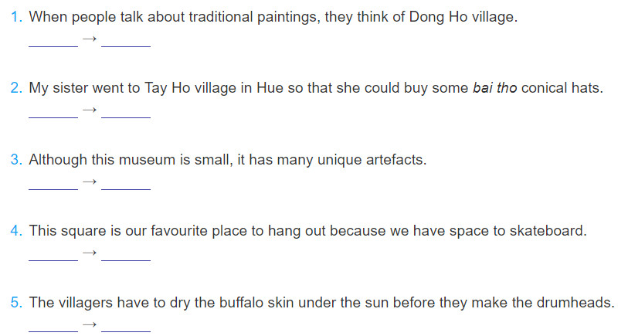
1.Underline the dependent clause in each sentence below. Say whether it is a dependent clause of concession (DC), of purpose (DP), of reason (DR), or of time (DT).
DT
DP
DC
DR
DT

Slide 14
2. Make a complex sentence from each pair of sentences. Use the subordinator provided and make any necessary changes.
1. The villagers are trying to learn English.They can communicate with foreign customer.( in order that)
The villagers are trying to learn English in order that they can communicate with foreign customers.
2. We ate lunch. Then we went to Non Nuoc marble village to buy some souvenirs . (after)
After we had eaten lunch, we went to Non Nuoc marble village to buy some souvenirs.
3. This hand-embroidered picture was expensive. We bought it . (even though)
Even though this hand-embroidered picture was expensive, we bought it.

Slide 15
2. Make a complex sentence from each pair of sentences. Use the subordinator provided and make any necessary changes.
4. This department store is an attraction in my city. The products are of good quality. (because)
This department store is an attraction in my city because the products are of good quality.
5. This is called a Chuong conical hat. It was made in Chuong village. (since)
This is called a Chuong conical hat since it was made in Chuong village.

Slide 16
Home work
Learn by heart phrasal verbs
Review dependent clause.
Do exercise Looking back 4,5
Prepare unit 1- communication.

