Slide 1
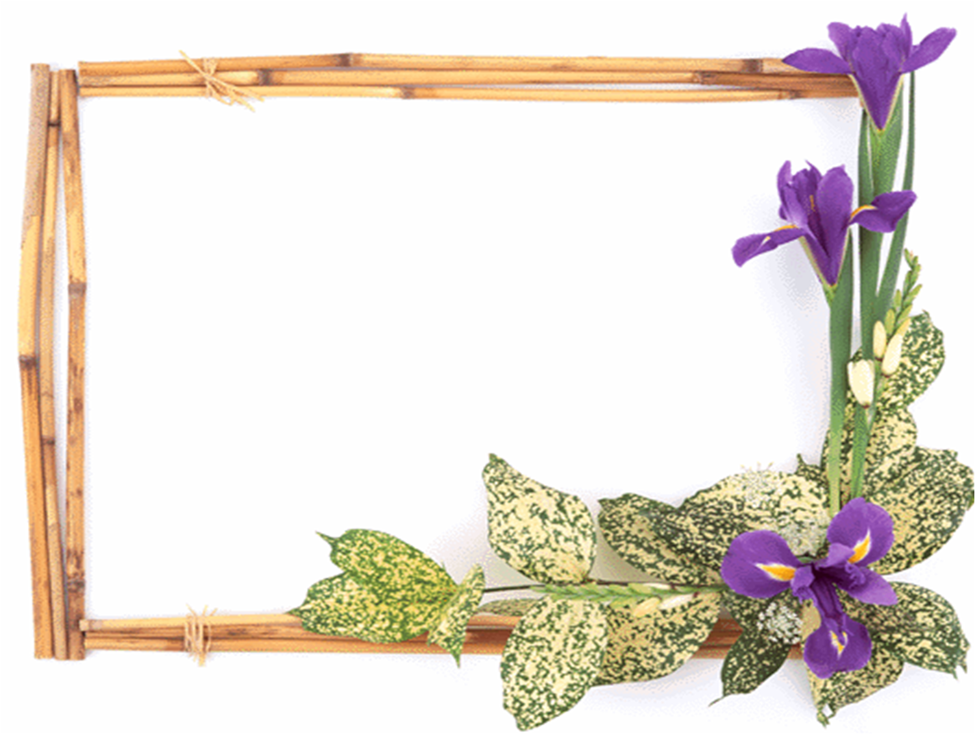
ENGLISH 9
Nguyễn Thị Mỹ Linh
Tan My Secondary school

Slide 2
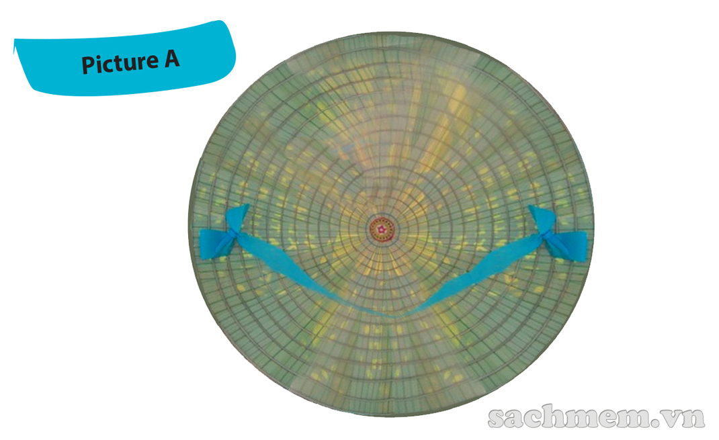
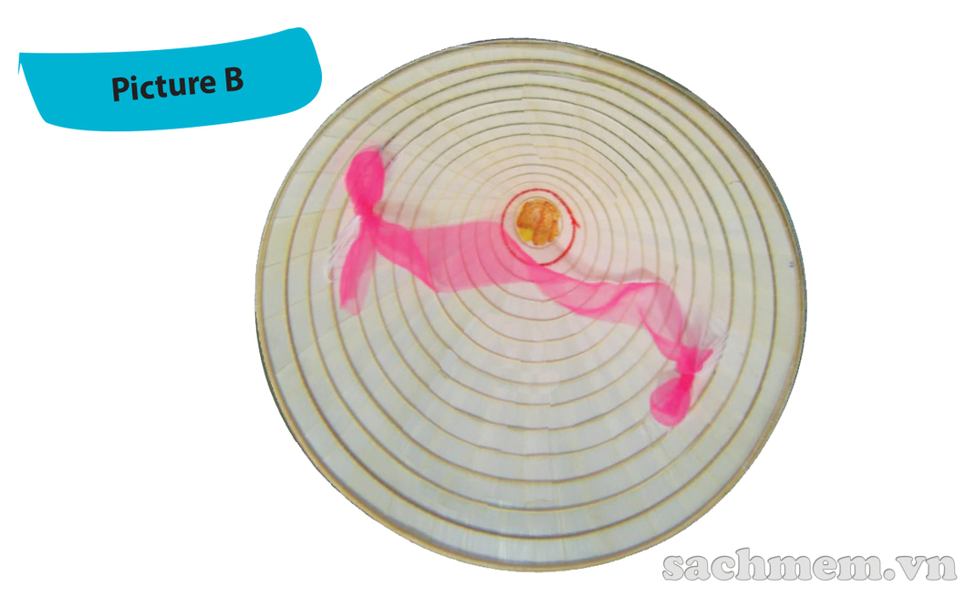
1. Work in pairs. One look at Picture A and other look at picture B. Ask each other question to find out the similarities and differences between your pictures
- Similarities:
conical hat,
string.
- Differences:
Picture A:
light green,
pictures between layers,
blue string,
look lighter.
Picture B:
white,
no decoration,
pink string,
look heavier.

Slide 3
Saturday, September 18th,2021
UNIT 1: LOCAL ENVIRONMENT LESSON 5: SKILLS 1
*.Vocabulary:
- authenticity (n):
tính xác thực
- layer (n) :
lớp ( lá )
- preserve (v) :
bảo vệ, bảo tồn
- treat ( v) :
xử lí (chất thải…)
- income (n) :
doanh thu, thu nhập
- take part in ( ph.v) :
tham gia
- stage (n):
giai đoạn
- frame (n):
khung

Slide 4
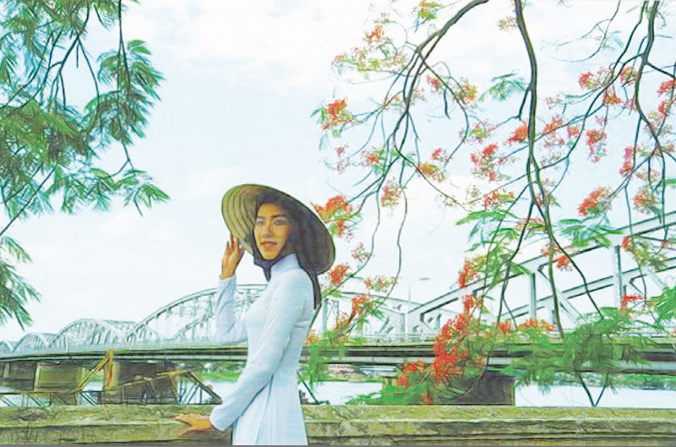
2. Mi visited Tay Ho village in Hue last month. She has decided to present what she knows about this place to the class. Read what she has prepared and match the titles with the paragraphs
Paragraph A:
1. Present status of the craft
Paragraph B:
2. Location and history of conical hat making village
Paragraph C:
3. How the conical hat is made

Slide 5
3. Read the text again and answer the questions
Why is Tay Ho the most well-known conical hat making village?
2. How far is it from Tay Ho to Hue City?
3. What is the first stage of conical hat making?
4. What is special about the hat layers?
5. What is special about the bai tho conical hat?
6. Who can make conical hats?
Because it is the birthplace of the conical hat in Hue.
It’s 12 km from Hue City.
It’s going to the forest to collect leaves.
They’re very thin.
It has poems and paintings of Hue between the two layers.
Everybody can, young or old.

Slide 6
SPEAKING
4. Read the following ideas. Are they about benefits of traditinal crafts (B) or challenges that artisans may face (C). Write B or C
B
1. providing employment
2. losing authenticity
3. providing additional income
4. relying too much on tourism
5. treating waste and pollution
6. preserving cultural heritage
C
B
C
C
B
Can you add some more benefits and challenges

Slide 7
5. Imagine that your group is responsible for promoting traditional crafts in your area. Propose an action plan to deal with the challenges

Slide 8
- Learn by heart the new words - Prepare for the next lesson ( Skills 2)
Homework

