Slide 1
ENGLISH 9
NGUYỄN THỊ MỸ LINH
Tan My Secondary School

Slide 2
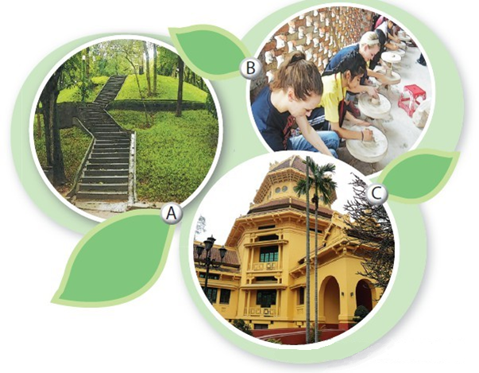
Bat Trang pottery village
Ha Noi Botanical Garden
Viet Nam National Museum of History

Slide 3
Listening
4Teen radio is asking different students about their places of interest.
1. Describe what you see in each picture. Do you know what places they are?
B. Bat Trang pottery village
A. Ha Noi Botanical Garden
2
C. Viet Nam National Museum of History

Slide 4
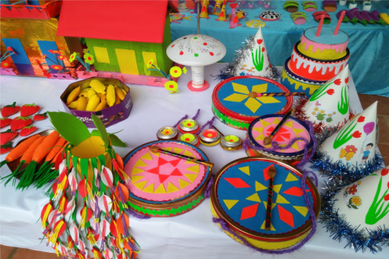
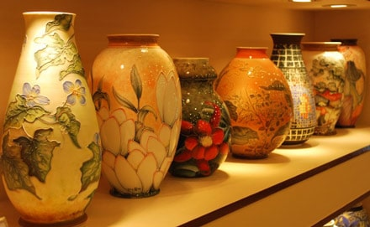
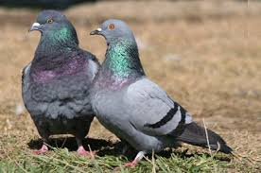
Saturday, September 18th, 2021
UNIT 1: LOCAL ENVIRONMENT
Lesson 6:Skills 2
I.Vocabulary:
-artefact (n):
đồ vật do con người tự tạo
-ceramic (adj):
(thuộc) nghề làm đồ gốm
-pigeon(n):
chim bồ câu
-various ( adj) :
khác nhau

Slide 5
II. Listening:
2. Listen to what these students say and decide if the statements are true (T) or false (F).
Tra is interested in history.
Nam likes making things with his hands.
Nam’s family owns a workshop in Bat Trang.
The trees in the garden only come from provinces of Viet Nam.
5. Hoa loves nature and quietness.
T
T
F
His friend’s relative
F
also
Different countries
T

Slide 6
3 Listen again and complete the table. Use no more than three words for each blank.
Student | Place of interest | Activities
Tra | Viet Nam National Museum of History | Seeing various (1) _________ Looking round and (2) _________
Nam | Bat Trang pottery village | - Learning to (3) _________ and (4) _________
Hoa | Ha Noi Botanical Garden | Climbing up (5) _________ Reading (6) _________ Feeding (7) _________ (8) _________ people
artefacts
exploring Vietnamese culture
make things
paint on ceramics
the hill
books
pigeons
watching
5

Slide 7
III. Writing
4. If a visitor has a day to spend in your hometown/city, where will you advise him/her to go? What can they do there? Work in pairs, discuss and take notes of your ideas.
Places | Activities
Place 1: Ben Thanh Market | shopping, eating
Place 2: Duc Ba Church | Pray for luck and health
Place 3: Independent Palace | Explore Viet Namese culture
6

Slide 8
Dear___________ ______________________________________ ______________________________________ ______________________________________ ______________________________________ ______________________________________ ______________________________________ ______________________________________ ______________________________________ Look forward to seeing you soon! Best wishes, __________
5: Imagine that your Australian pen friend is coming to Viet Nam and will spend a day in your hometown/city. He/She has asked for your advice on the places of interest they should go to and the things they can do there. Write an email to give him/her some information.
From:
To:
Subject: Places of interest in my hometown/city
7

Slide 9
Dear Mary,
It's great to know that you're coming to Viet Nam. I hope you’ll have a good time spending one day in HCM City.
There are many interesting places in the city, but I think within one day you are able to visit three places. The first place I suggest is Ben Thanh Market. You can buy anything. The second place is Duc Ba Church.You can pray for luck and health.The third place is Independent Palace.You can also wander around and explore Vietnamese culture.
Tell me when you're coming, so I can show you around these places.
Look forward to seeing you soon!
Best wishes,
..................

Slide 10
HOMEWORK
- Learn by heart vocabulary
- Prepare: Project
- Review phrasal verbs.

